Slide 1
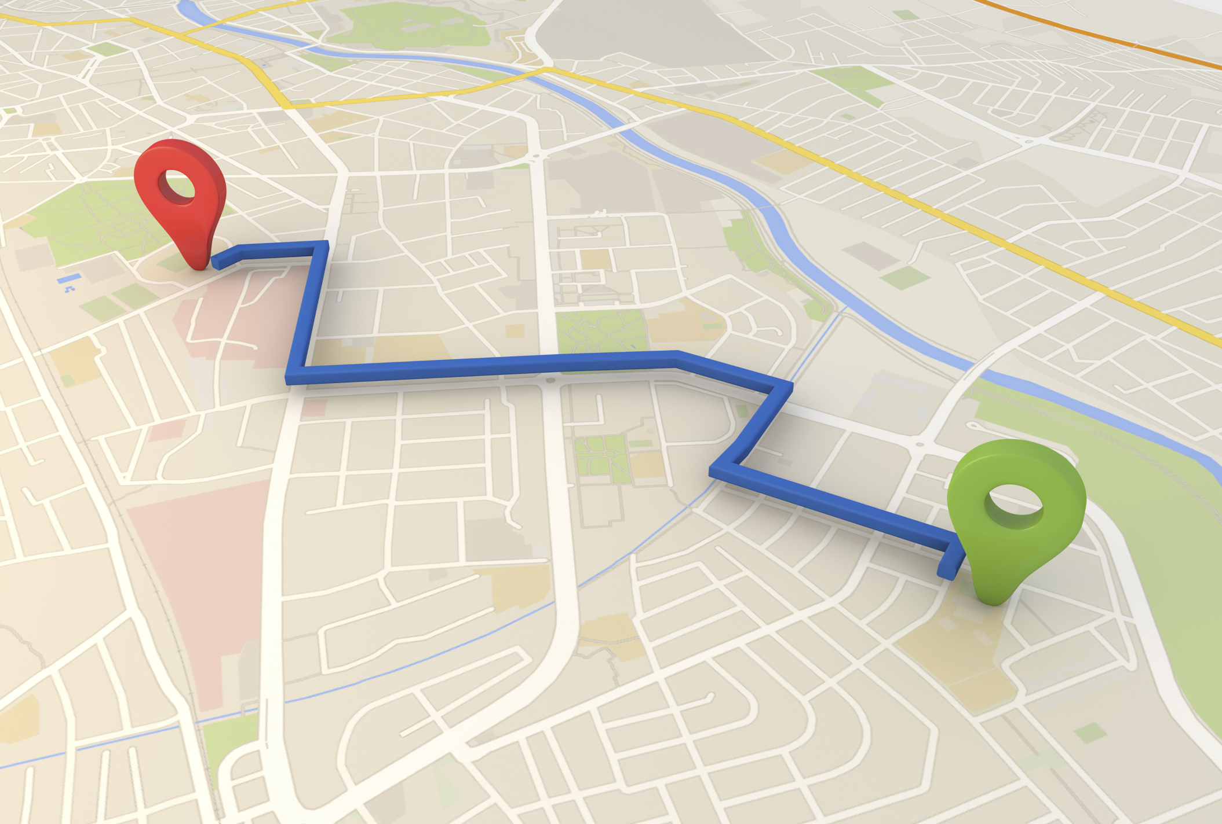
Strategic Plan Fairmont, NE
Terry Meier
Jeff Ray

Slide 2
Question 1

Slide 3
Question 2

Slide 4
Question 3

Slide 5
Question 4

Slide 6
Question 5

Slide 7
Question 6

Slide 8
Question 7

Slide 9
Question 8

Slide 10
Question 9

Slide 11
Questions 10

Slide 12
Question 11

Slide 13
Question 12

Slide 14
Question 13

Slide 15
Question 14

Slide 16
Question 15

Slide 17
Question 16

Slide 18
Question 17
Are there additional services or businesses that you wish were in Fairmont? If so, what?
Grocery Store Dump Station for Campers
Café Youth Rec Center
Dollar General Fitness Center
Convenience Store Pave all Streets
Attract and retain workforce

Slide 19
Question 18
What other ideas do you have to better the Village?
Focus on recruiting young families
Business/economic development
Nuisance abatement (property maintenance)
More housing choices
Community events
Roads and sidewalks

